Slide 1
What Works for Financial Sector Development?
A review of the evidence
DIIS
December 2nd 2014

Slide 2
FSD: ToC - Overview
Policies & Institutions
Support Functions
Long term Finance
Financial Deepening
Financial Inclusion
Reduced risk of financial shocks
Better info., security to lend
Long term savings=investing
Higher private investment
Poor, marginalised able to save/ invest/insure
Outcome
Stable, deep & inclusive financial system
Financial stability
Financial depth
Higher investment
Pathways out of poverty, avoid poverty traps
Impact
Sustained economic growth, poverty reduction

Slide 3
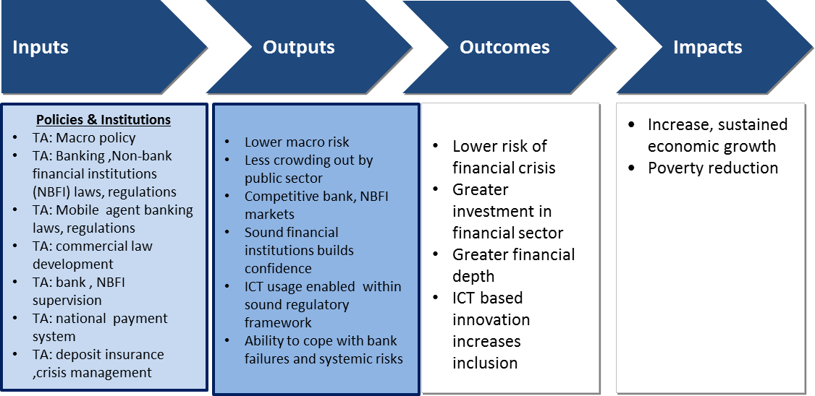
Results chain: Policies & Institutions

Slide 4
Evidence: policies, institutions
Policies, institutions=stability financial development
Financial shocks=recessions, increased poverty. Strong evidence, 2009, Asian crisis
30% variation in rates of poverty reduction attributable to cross-country
variation in financial development
Strong evidence that macro stability, liberal policies and effective prudential
regulation lead to financial . But liberalisation not leading to lower spreads.
Strong evidence that creditor rights, contract enforcement and bankruptcy laws
lead to financial development
Essential for Systems Approach

Slide 5
Results Chain: Support Functions
Support Functions for Stability, Deepening & Inclusion

Slide 6
Evidence: support functions
Support functions=better information security of lending efficient infrastructure skilled workforce
Good evidence that credit bureaus, collateral registries contribute to greater lending.
Good evidence that payments infrastructure, inter-operability, rating systems
lead to efficiency
But supply driven. Information on demand can make a difference
(low cost accounts, savings) but is woefully inadequate. Many products fail
Many programmes fcous on skills but lack of good evidence on outcomes
Enabler of Systems Approach

Slide 7
Results Chain: Long Term Finance

Slide 8
Evidence: Long Term Finance
Demigurc-Kunt and Levine (1996) – Financial development leads to increase
in the assets of the banking system and non-bank financial institutions
Financing for infrastructure shown to have good results and some evidence
to support impact investment
But macro evidence of link between stock markets and growth is weak. Micro
Evidence shows link to credit and growth but not conclusive.
Evidence for pensions and insurance weak; many studies show reverse
causality. Micro insurance is growing rapidly but results not as expected
and some products have proved expensive failures.
Impact may be on FSD not growth or poverty. More research needed.

Slide 9
Results Chain: Financial deepening

Slide 10
Evidence: Financial Deepening
Private credit/GDP = higher investment consumption smoothing
investment in human capital
Causality of deepening to growth has been proven robustly. Strong evidence for
depth and growth in country. But pathways not well understood.
Positive links with reducing inequality, hunger, resilience to shocks and poverty but
transmission pathways not well researched.
Link between A2F and SME growth strong but not panacea, works with
transformative enterprises only.
Impact of deepening on growth & poverty is robust

Slide 11
Results Chain: Financial Inclusion

Slide 12
Evidence: Inclusion
Weaker macro evidence in support of inclusion. Linked to depth and this does reduce inequality/ poverty.
.
BUT still important for poor: to support livelihoods/ diversification, finance health,/education, smooth consumption, promote resilience.
Financial literacy only works at teachable moments, allied to products.
Past focus on mircocredit. But better understanding now that poor need savings, insurance, payments.
Despite financial diaries, dont know much about demand.

Slide 13
Evidence: Microfinance
Microcredit – No miracle, used for consumption, modest benefits but essential for entrepreneurs
Limitations of one-size fits all. Small sums, not tailored to need. Works better when vary terms. Gap between MFIs, banks.
Stronger evidence for micro savings & smoothing consumption.
Mirco insurance – very little evidence. Little demand.
ICT – no evaluations done. But reduces costs and increases outreach
Need for further research

